Slide 1

Trust in official statistics and quality of governance strengthen trust in institutions and politics
Evidence from OECD survey on trust
Session : Democracy dies in the darkness without statistics
Vilnius, May 2026
IAOS
Dr Serge Allegrezza • Dr Wolfgang Langer •
Dr Majlinda Joxhe

Slide 2
Motivation:
Trust in institutions and politics is a cornerstone of democratic governance (democracy: 26% of world population, liberal democracies: 7%)
Declining trust observed across many advanced democracies, risk of “deconsolidation”
Misinformation and polarization of facts challenge evidence-based policymaking
Key question: Does trust in official statistics help build trust in politics and institutions?
Notes:
V-DEM (2026): 26% of world population is a democracy (7%: Liberal democracy) 2005: 50%
92 autocracies, 87 democratic countries

Slide 3
Why Trust in Statistics?
Public statistics underpin:
  Policy evaluation
  Accountability
  Public debate
Citizens have a limited trust in statistics
  Mis - and disinformation
  Lack of numeracy
  Tension: emotions versus facts
Notes:
39% trust information when backed by statistics (Eurobarometer 2024)
Trust in Eurostat : 67% (Eurobarometer 2024)
Across the OECD, 42% find it likely that government decisions are evidence-informed
OECD’s 2024 Serving Citizens’ survey finds that while 23 of 31 (74%) reporting countries collect data related to performance targets, only 16 of 31 (51%) actually incorporate these data into their decision-making processes (OECD, forthcoming).
Citizens are caught in tenstion between emotions and facts to make their judgement. Often feelings trump facts.

Slide 4
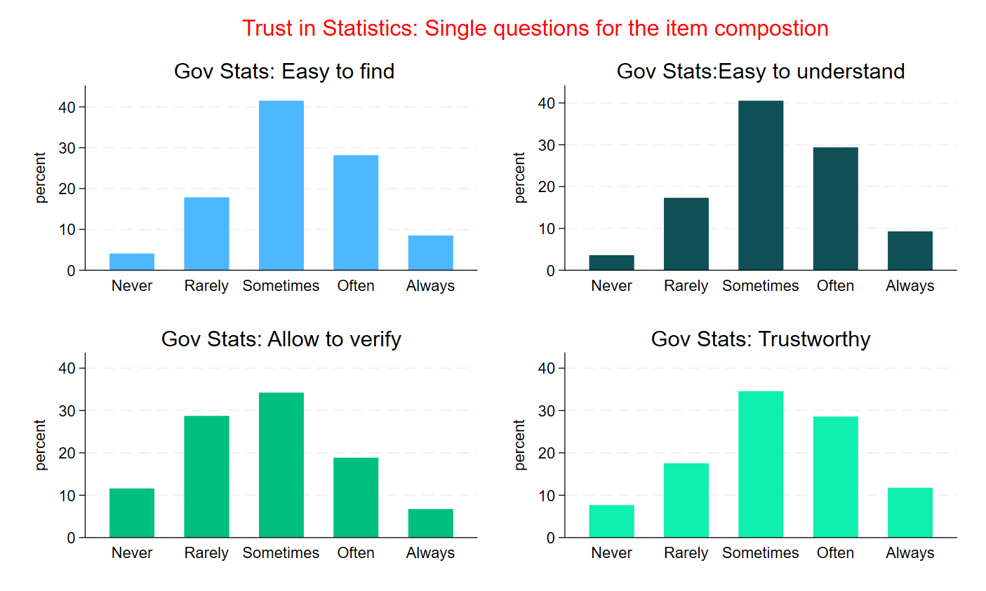
40% find statistics trustworthy (OECD, 2023)

Slide 5
How is trust measured?
Trust in politics factor of confidence derived from:
Trust in national government
Trust in local government
Trust in parliament
Trust in political parties
The Trust in Institutions factor of confidence from
Trust in police
Trust in civil servants
Trust in the courts and legal system
Trust in official statistics
Governmental statistics :
are easy to find
are easy to understand
allow you to verify whether the government keeps its promises
are trustworthy
Quality of Governance factor encompasses sub-factors and their respective items
Integrity, Responsiveness, Reliability, Openness, Fairness , Satisfaction with Public Services
*All indicators are measured on an eleven-point Likert scale (0 to 10), treated as continuous variable
explanandum
explanans
Notes:
What are the indicator to substantiate the underlying trust factors.
The first to trust factors (institutions and politics) are explained by trust in official statistics (factor) and quality of governance (factor)

Slide 6

Data
OECD Trust Survey 2023
37,133 respondents, 26 countries
First time "trust in statistics" included in OECD governance survey (2023)

Slide 7
Confirmatory Factor Analysis
A CFA model on trust dimensions: political, institutional, official statistics and perceived quality of governance
Trust in politics and trust in institutions are highly correlated (0.85)
Trust in statistics is moderately correlated with the other two (0.56–0.60), capturing a distinct dimension of confidence
Model fit robustness: RMSEA=0.045; CFI=0.94
Notes:
We constructed the factors subsuming the indicators of trust in various domains: politics, institutions, governance quality, statistics by applying a confirmatory factors on all the countries

Slide 8
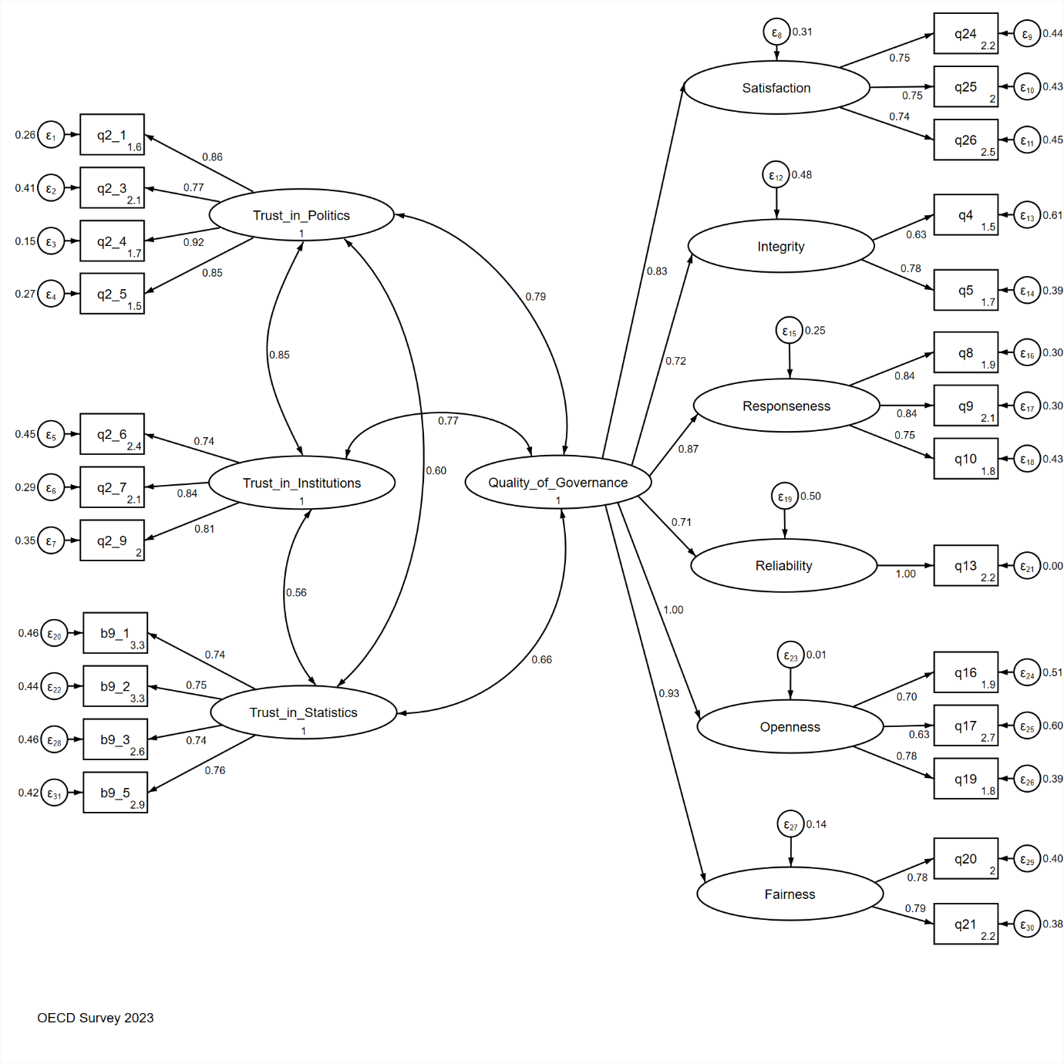
Notes:
We see here the model estimated with the Stata Sem model for all the countries simultaneously . We estimated the same model on 2023 and 2022 to check the stability and reliability of the trust model for institutions and politics as well as quality of governance (without trust in statistics, no panel data).
The good news is that the measurement model stood up with a very good fit.

Slide 9
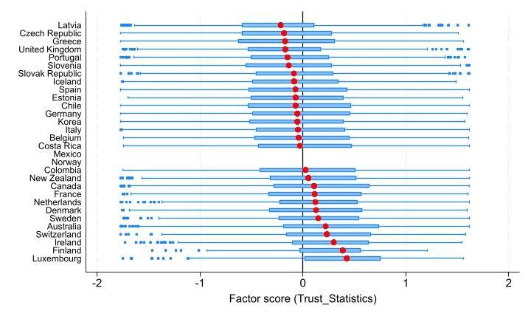
Notes:
Let’s look more closely to trust in statistics. The factor score measures the trust placed in statistics by country. Red is the average score.
We are at the core of the trustfulness of statistics. Malta and Lithuania did not participate.

Slide 10
Trust in Statistics across countries:
Large cross-country differences
High trust in statistics: Nordic countries, Switzerland, Luxembourg
Low trust: Latvia, Czech Republic, Greece, UK
Explaining trust differences between countries : economic performance & cultural effects?

Slide 11
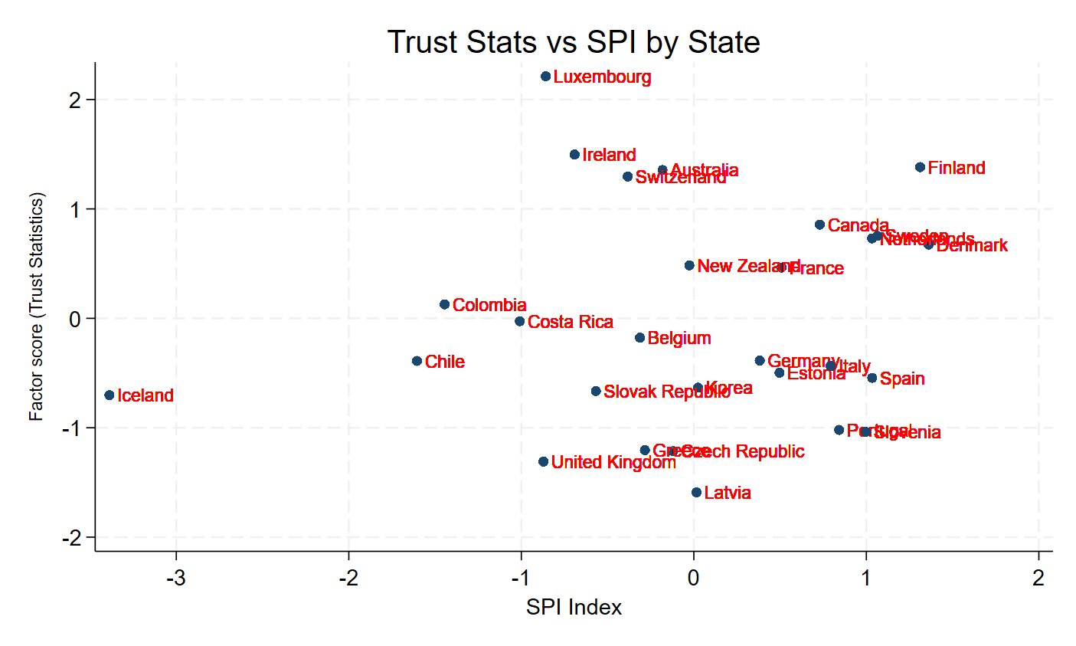
Trust in Statistics vs Statistical Performance
Notes:
One of the topics which is of interest in this study is trust in statistics (perceived) on Y axis and on the X axis
objective quality of statistics measured by the Worldbank SPI. There is a mild correlation between the 2 dimensions.
A regression 2 level of trust in statistics and spi at macro level show that spi is not significant!
Trust in statistics at individual level and objective quality of statistics at macro level will enter 2 level regressions , SPI index is not significant.

Slide 12
Two level regressions:
Combined micro and macro model
Level 1: Explanatory variables
Trust in statistics (“demand side”) (+)
Trust in quality of governance (+)
Gender, education, income (+)
Political engagement, efficacy (+)
Trust in media, classic (+) social networks (ns)
Social trust (+)
Foreign born (+)
Level 2: Explanatory variables
GDP per capita (+)
Political stability (+)
Non corruption indicator (+ )
Statistical performance (“supply side”) ns

Slide 13
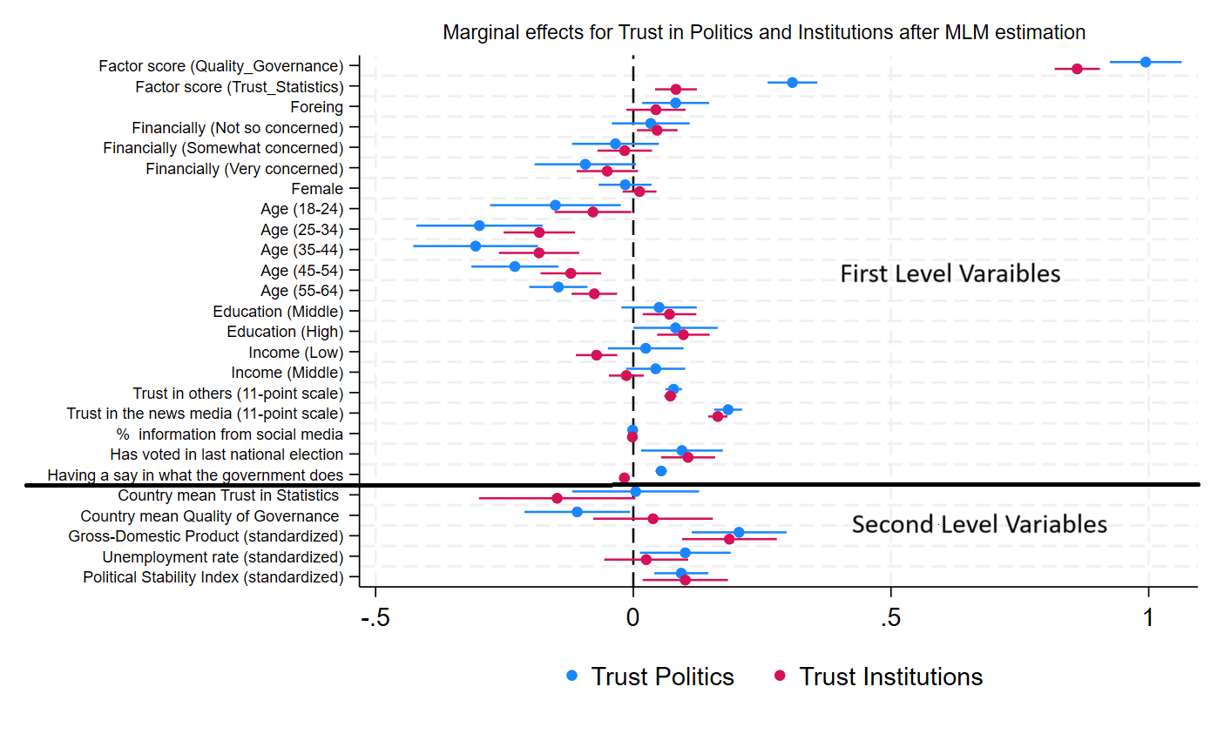
Notes:
Upper part of the plot: individual effects
Below the macro variables .

Slide 14
Key Findings:
To our knowledge, this is the first study to explore econometrically how much trust in official statistics contributes to trust in politics and institutions at OECD level
Trust in statistics is a significant additional explanatory variable of trust in politics and institutions
Quality of governance, political efficacy, general trust have a positive impact
GDP/capita, political stability have a positive effect
SPI (objective quality of statistical system, World Bank) : no effect!
Notes:
To our knowledge, this is the first study to explore econometrically how much trust in official statistics contributes to trust in politics and institutions at OECD level.
Trust in statistics is significant besides the quality of governance while the SPI is not. Subjective trust trumps objective quality of statistics.

Slide 15
Policy Implications:
Official statistics make a difference!
“Supply side”(NSI view):
strengthen independence & transparency of National Statistics Institutes (legal, regulatory and culture)
“Demand side”(citizen view):
-fight against dis- and misinformation,
-pre-and debunking, fact checking
-numerical/statistical literacy
Tangible results matter more than stats. Delivering for democracy! (Fukuyama et al. 2025)
Notes:
We do we go from here?
It is not because the spi index is not statistically significant that we should disregard efforts of statisticians applying strictly the Code of practice
But we want to argue that we have to take into account the view of citizens (“demand side”), which has a strong bearing on trust in institutions and politics. We have to question how citizens extract and process information in an environment saturated with information of varying quality and laden with emotions of varying intensity. Besides economic science, we should look to political science or social psychology, which have been studying these issues empirically for a long time. Research shows that it is possible to fight successfully dis and mis information by fact checking.

Slide 16
Methodological improvements:
Introduce common standardized questions on trust in official statistics through surveys in various countries over time
Use of panel data and “(quasi-)natural experiments”. Examples: effect of removing head of statistics agencies or deleting relevant indicators from website (causal inference)
Test systematically the impact of statistical inoculation and fact checking (debunking) on numeracy, attitudes and beliefs of citizens
Notes:
We had a hard time to convince the oecd secretariat to put some questions on quality of statistics (independence, accountability, objectivity…)
For the 2023 survey. Once only. We advocate to repeat this exercises in internationally comparable surveys over time so as to check for the stability and reliability of measurement and provide panel data.
Causal inference can be assured if we find events which allow to find some exogenous instrument. See paper by Bloom et al, 2026
Literature in social psychology has shown the positive effects of fact checking. This kind of tests should be performed by NSI to evaluate the impact of statistical information.

Slide 17
Thank you for your attention!
Get the companion paper
“Trust in official statistics and quality of governance strengthen trust in institutions and politics. Evidence from OECD survey on trust”
Serge Allegrezza, Wolfgang Langer, Majlinda Joxhe

Slide 18
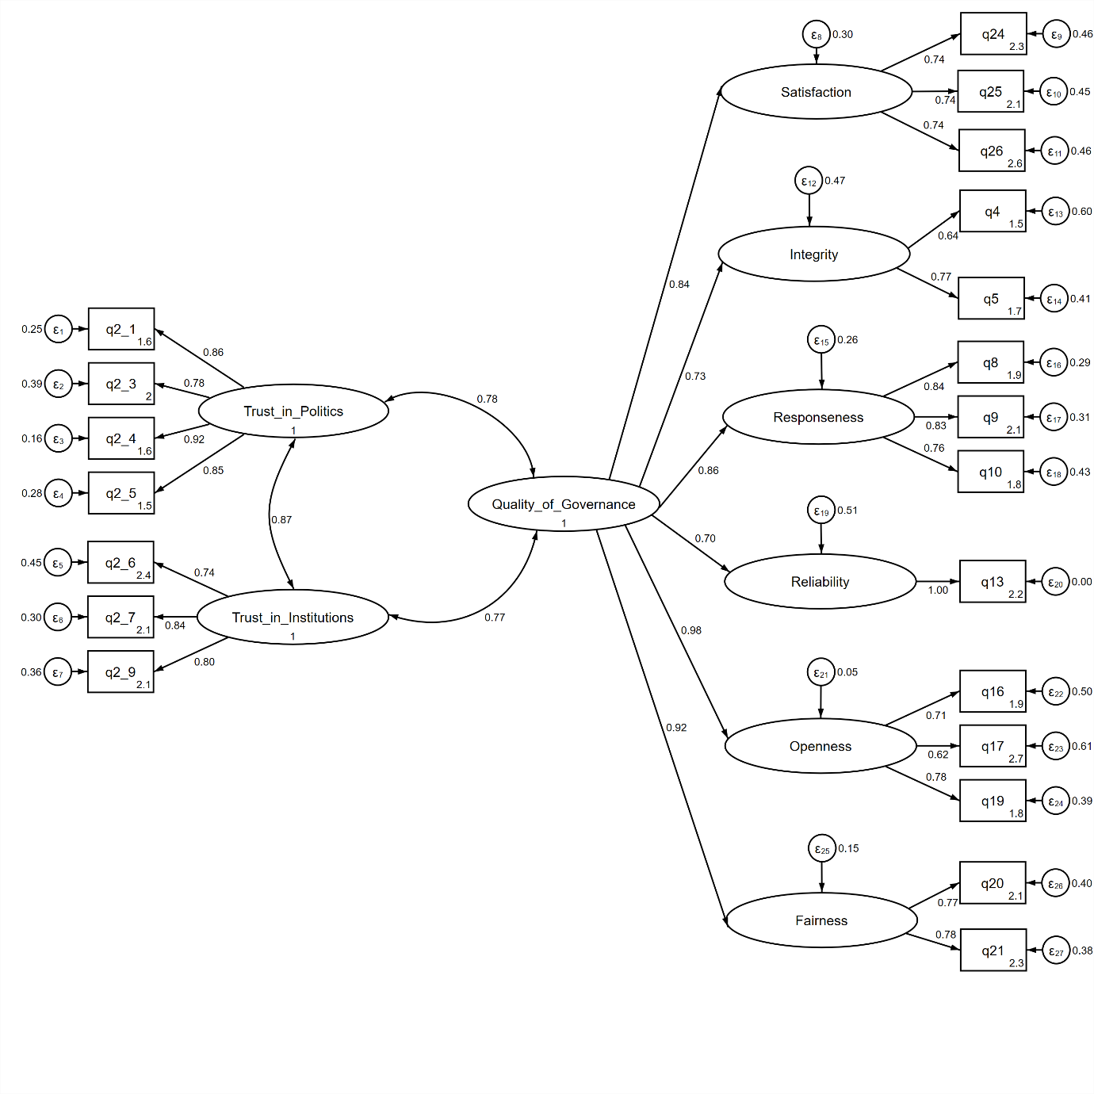
APPENDIX: Stability of the CFA model for Trust OECD 2021-2023

